Slide 1


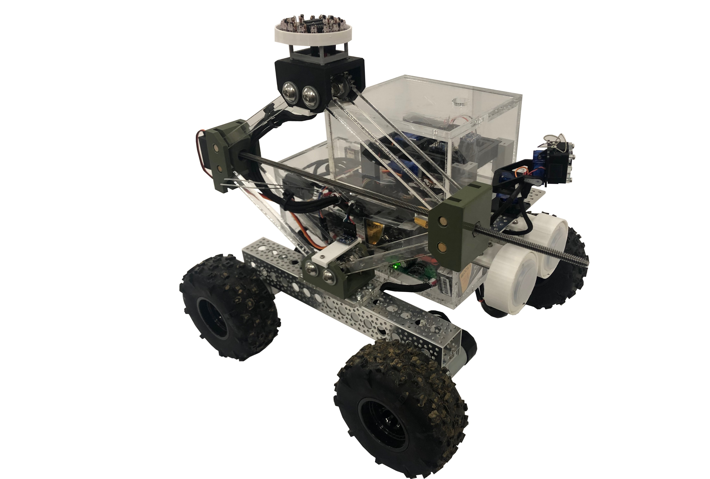
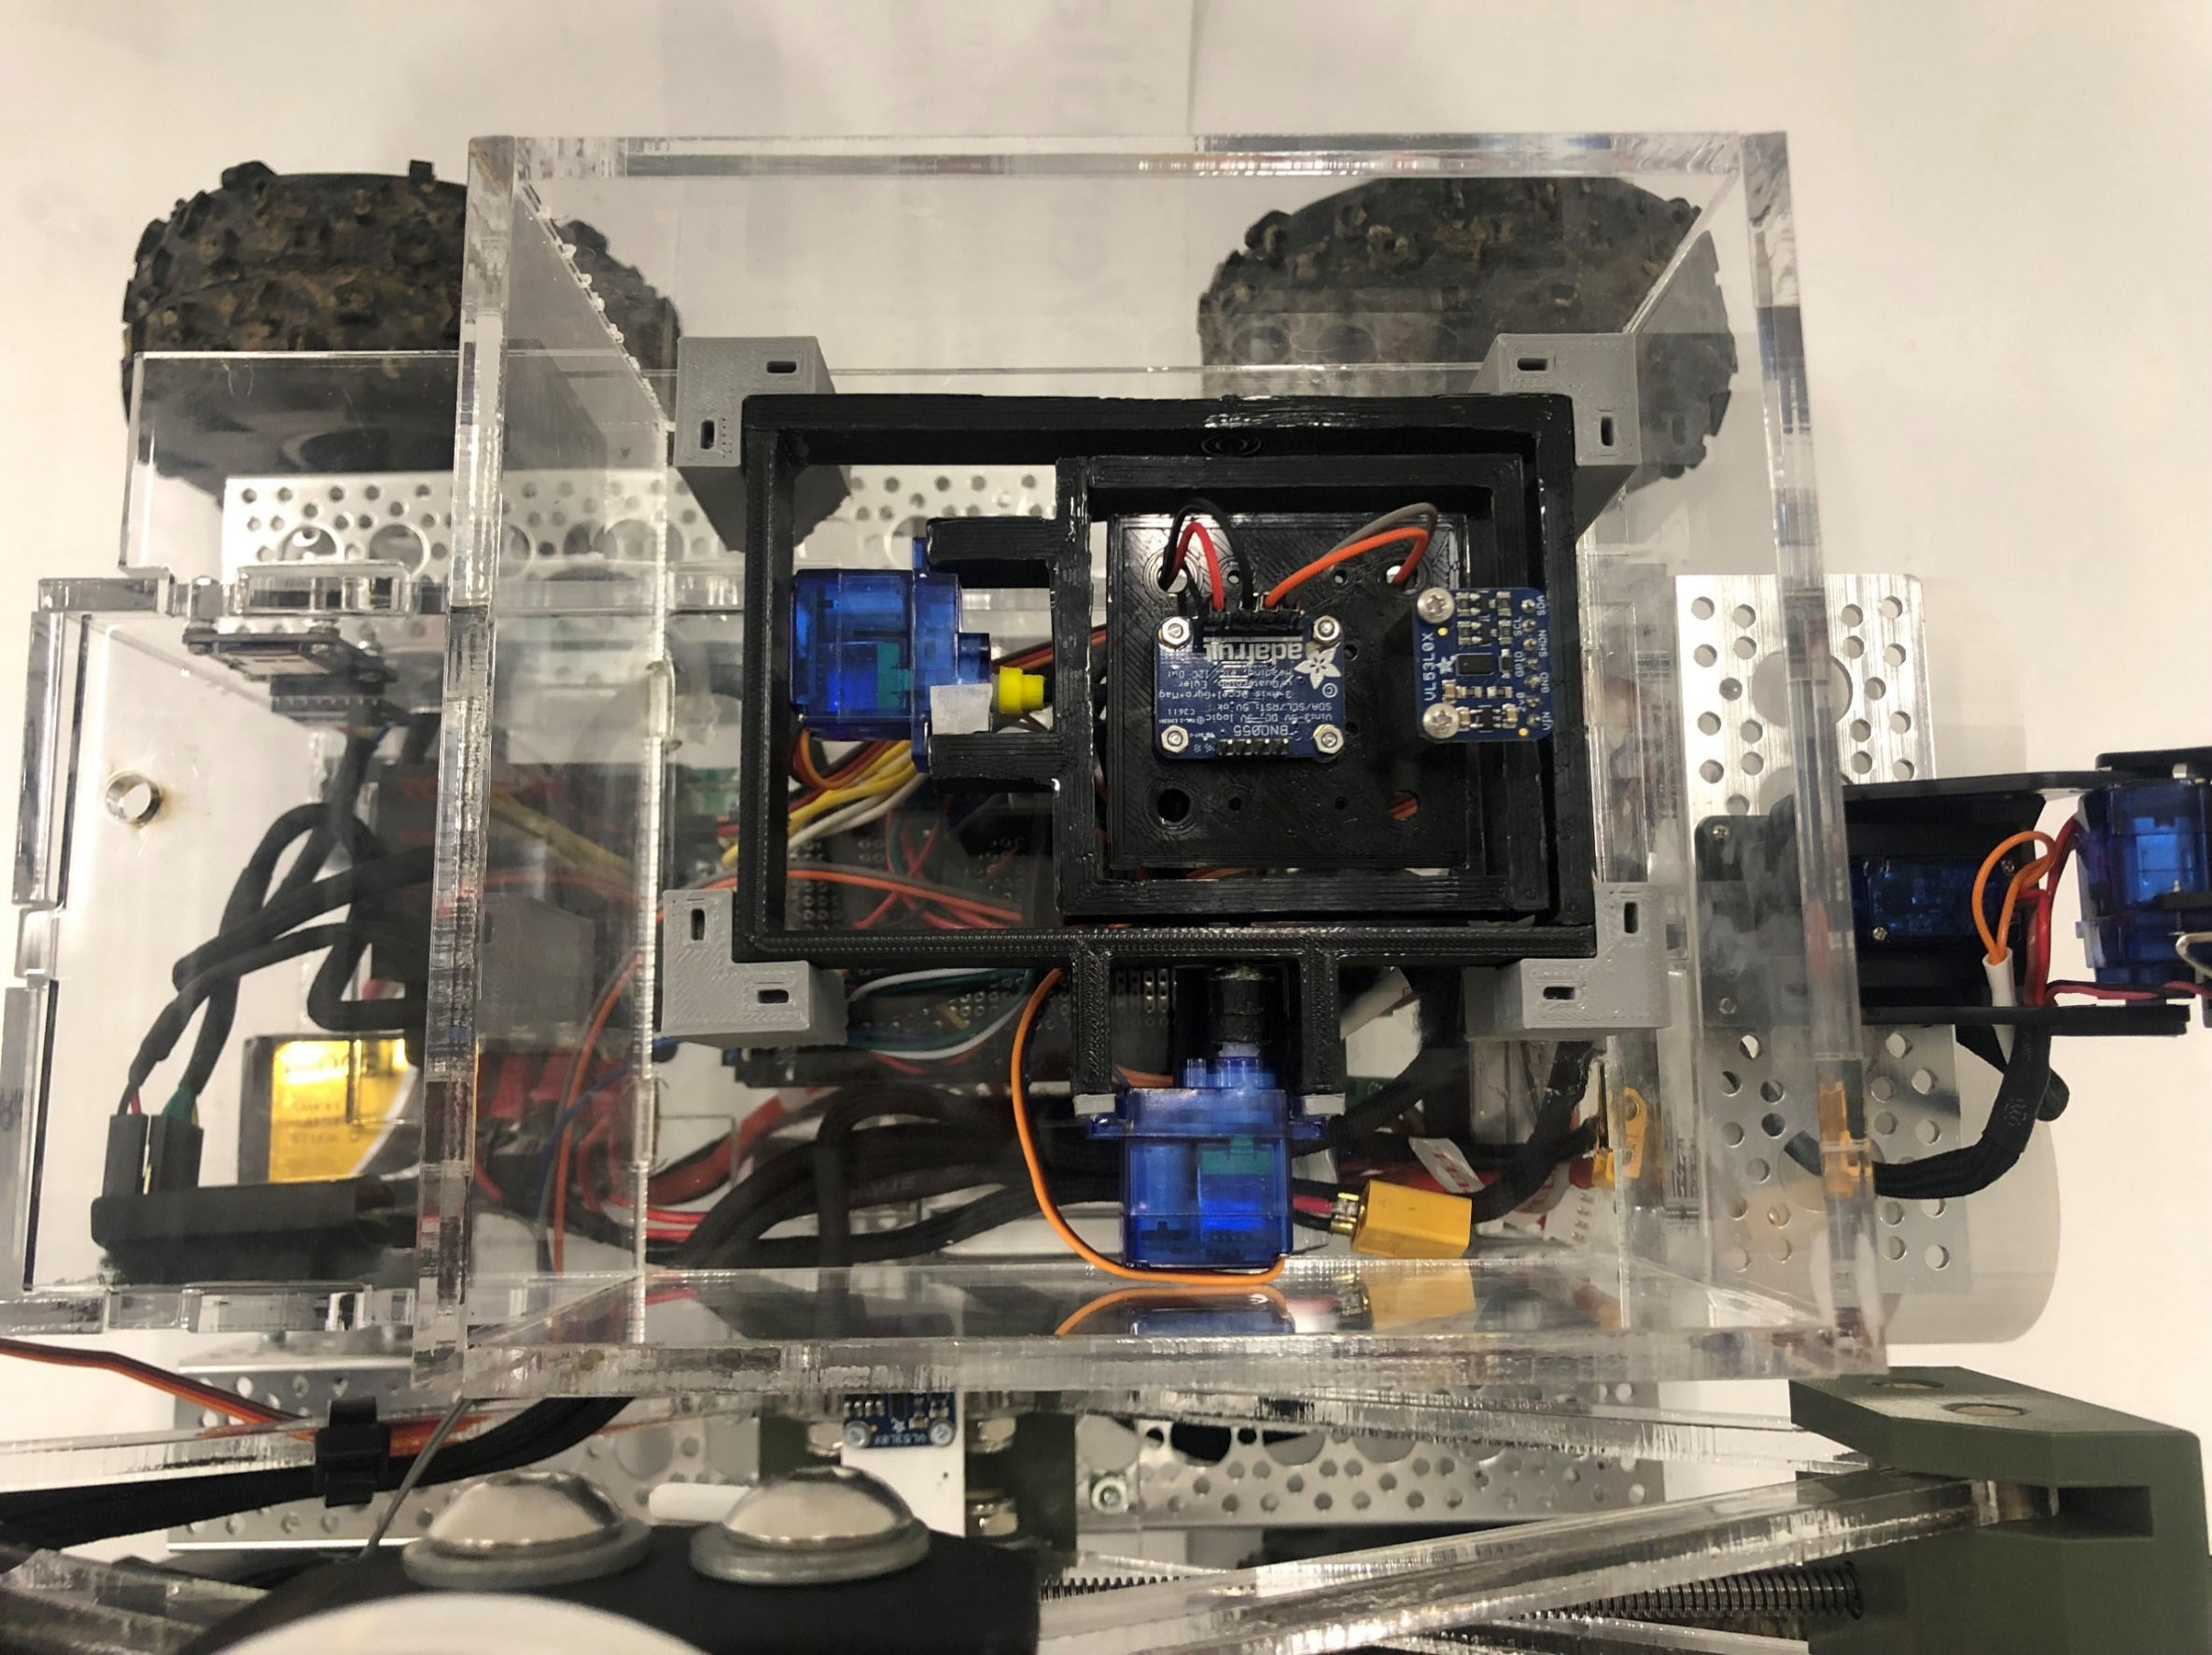
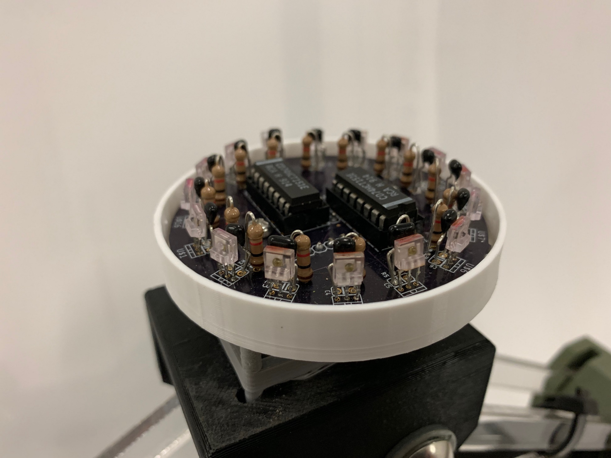
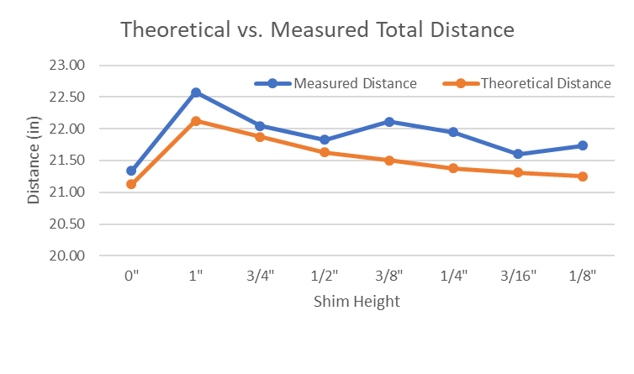
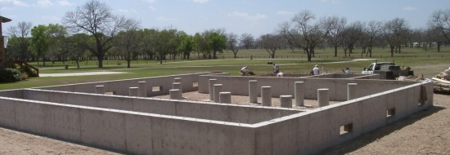
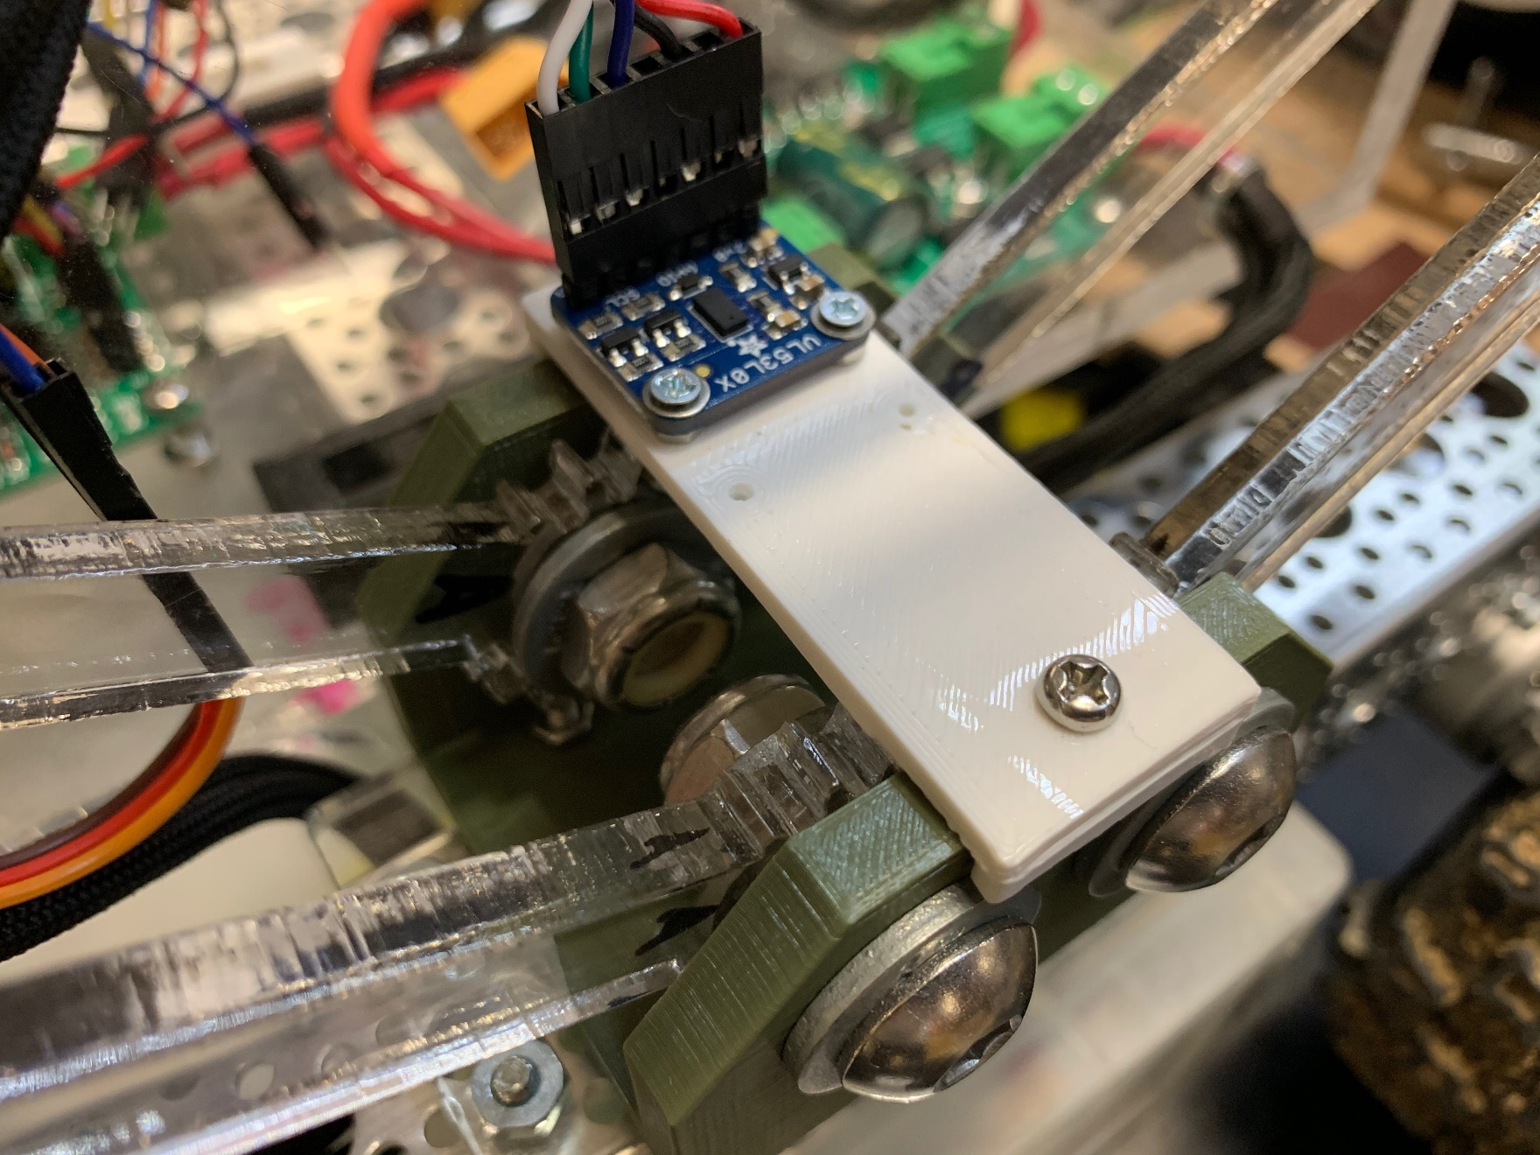
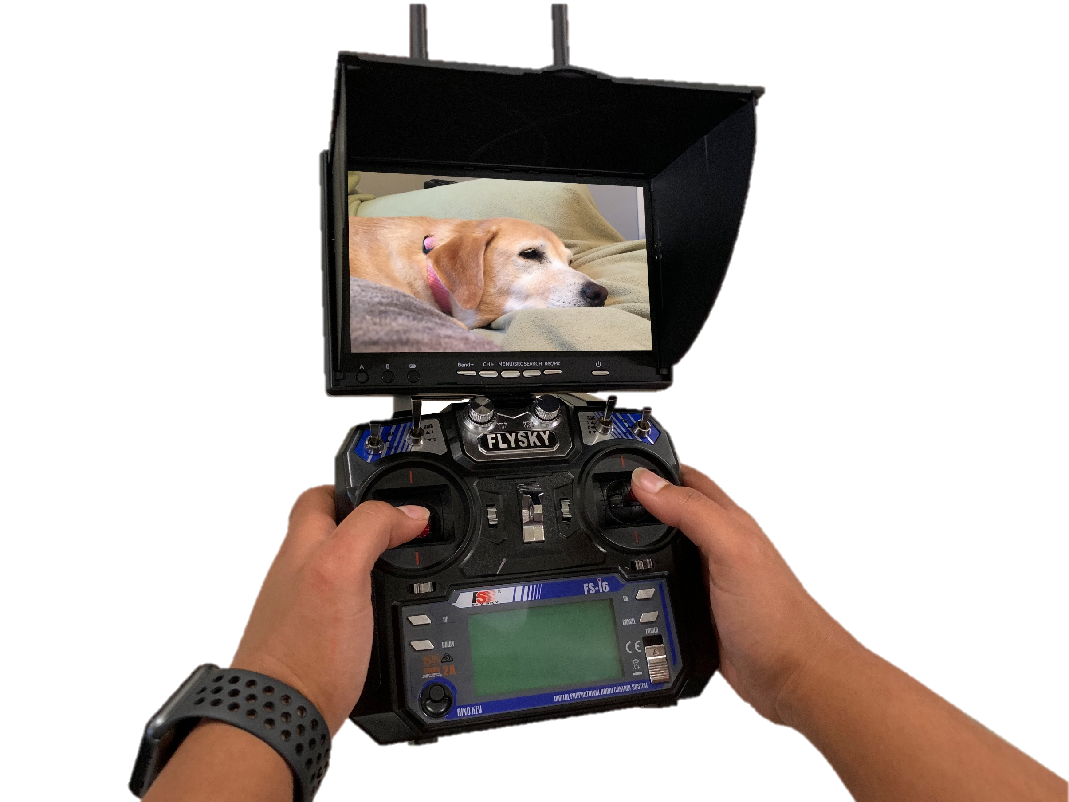



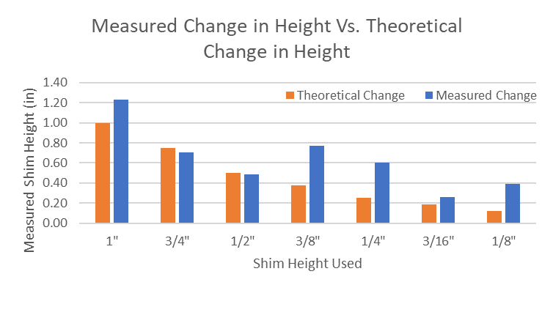

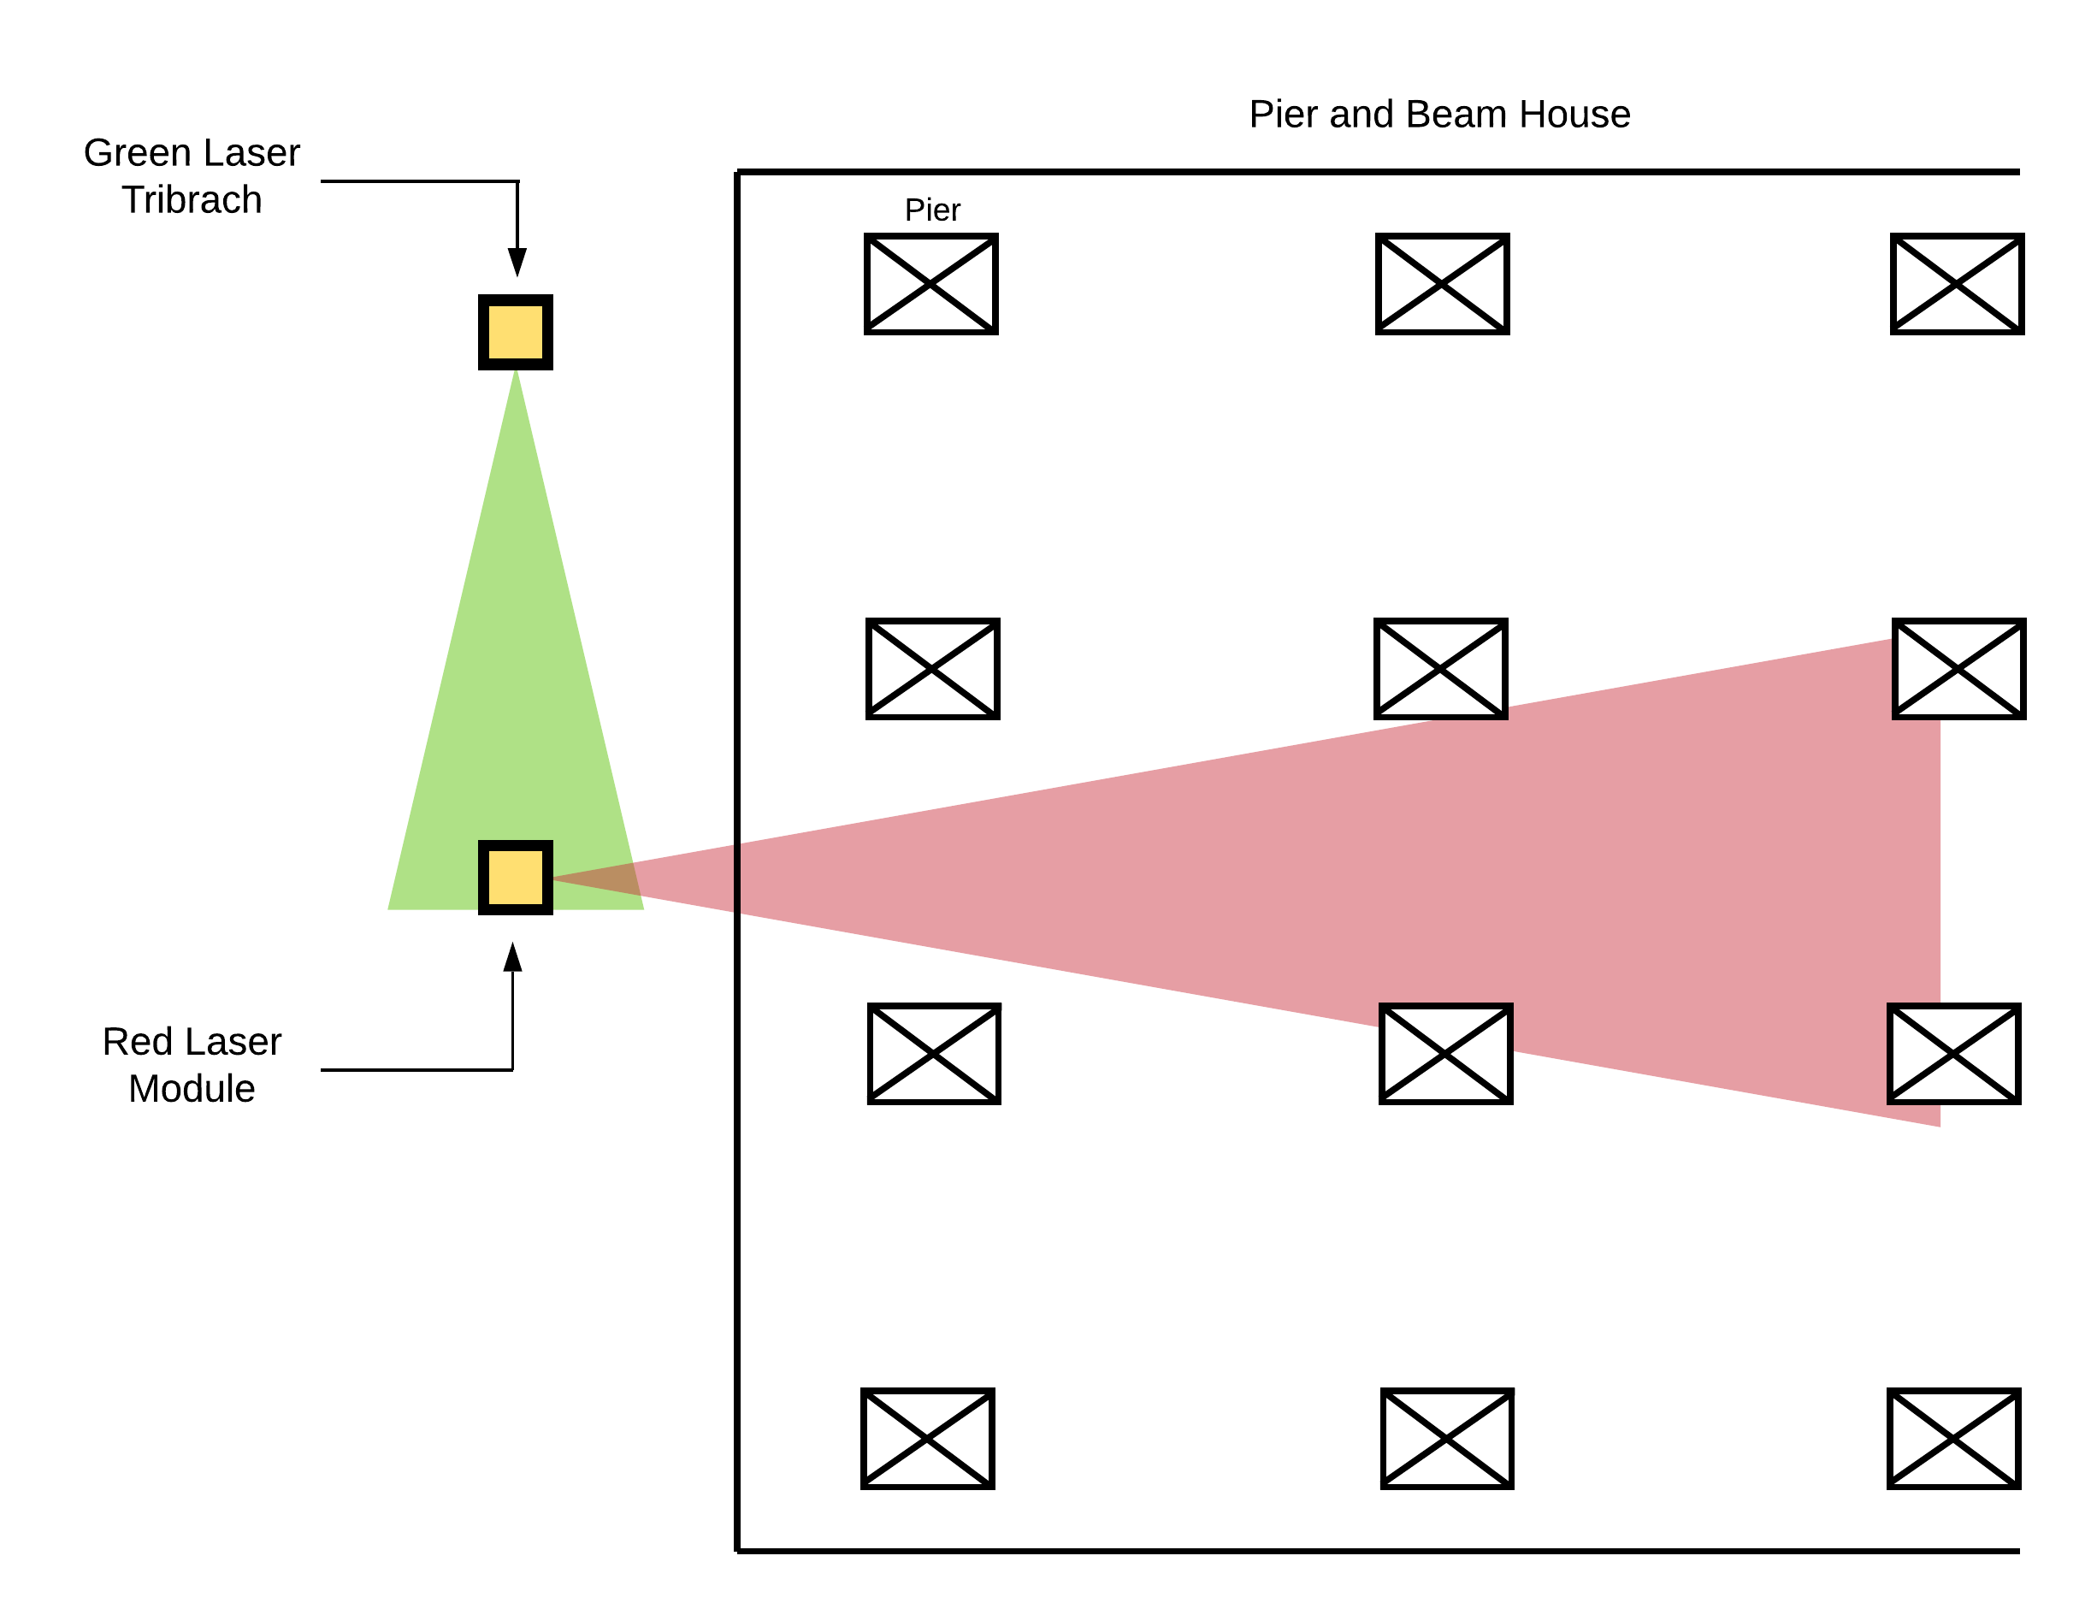
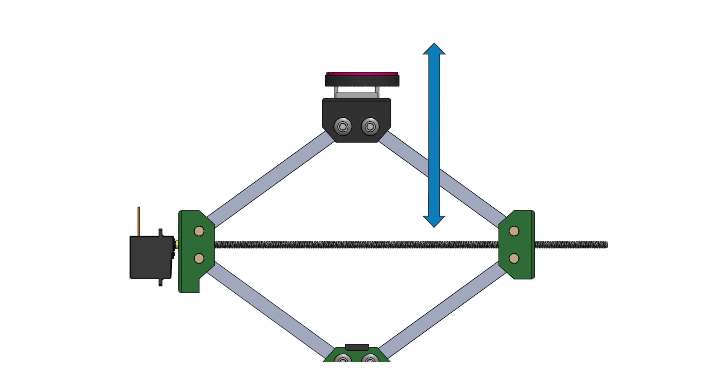
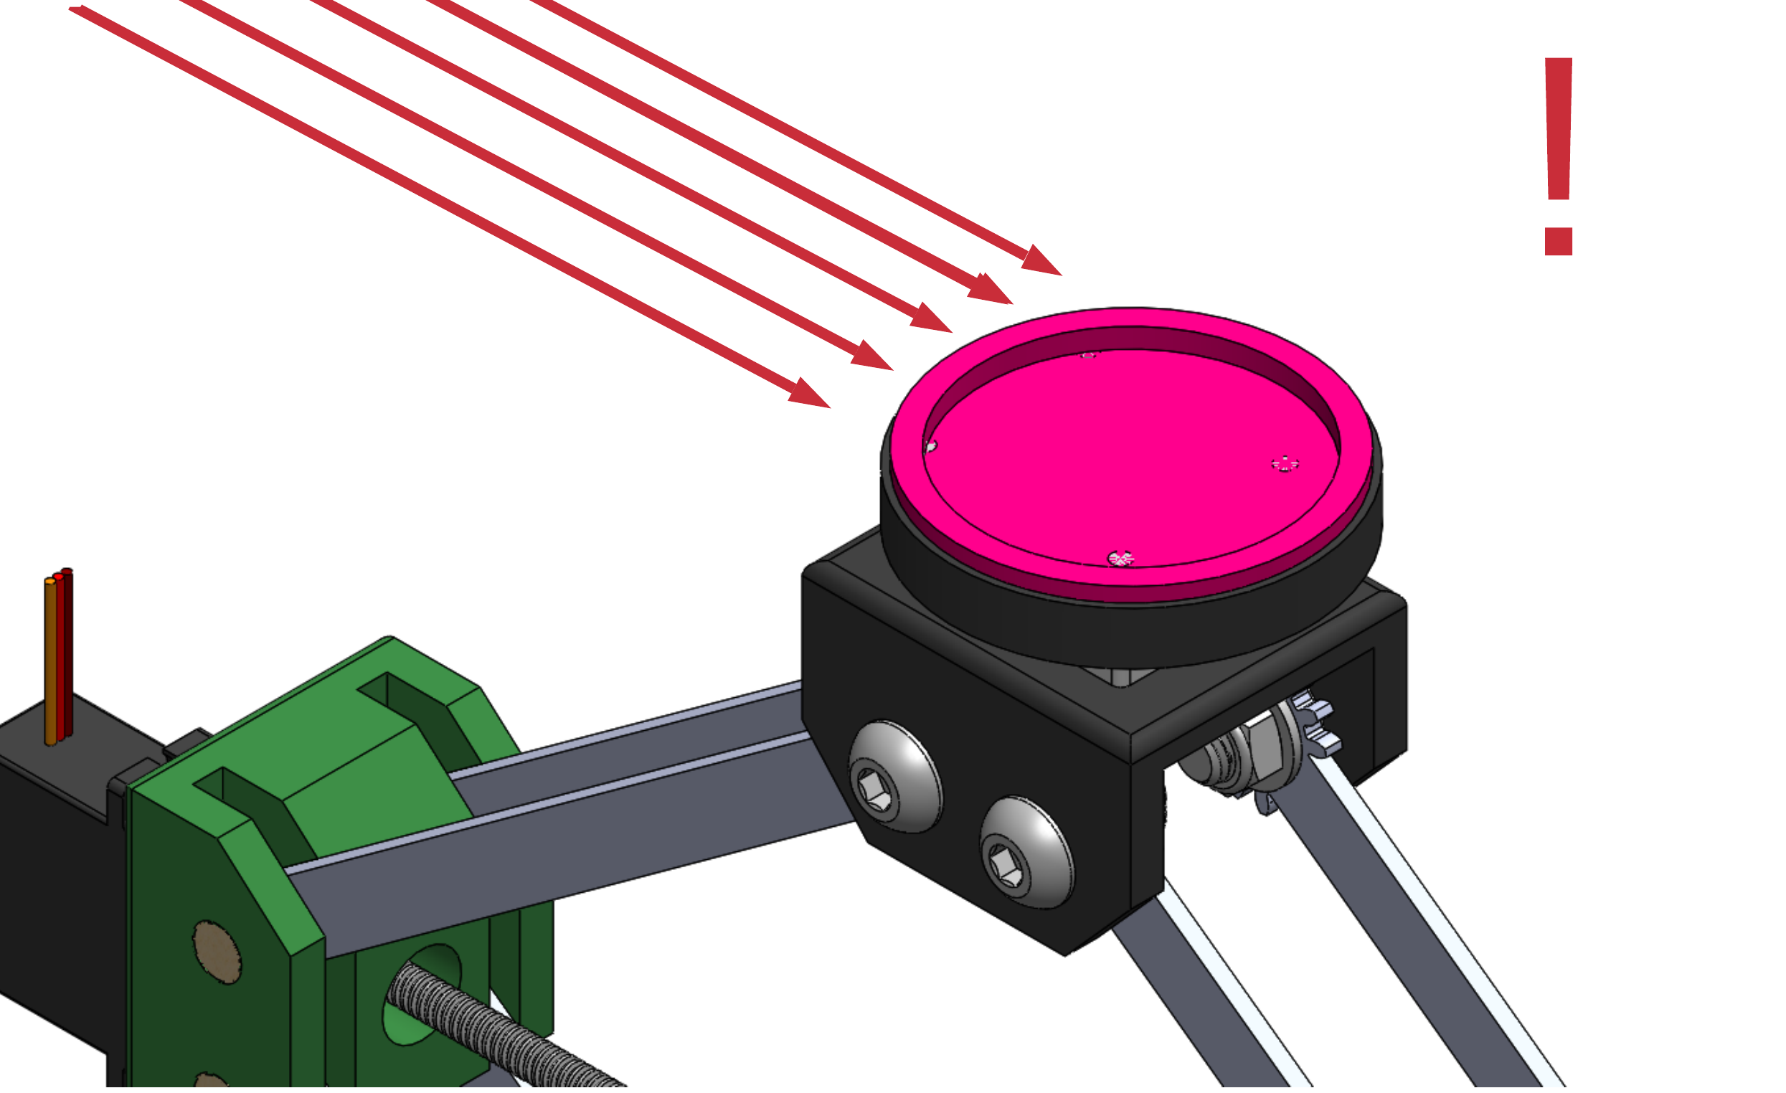





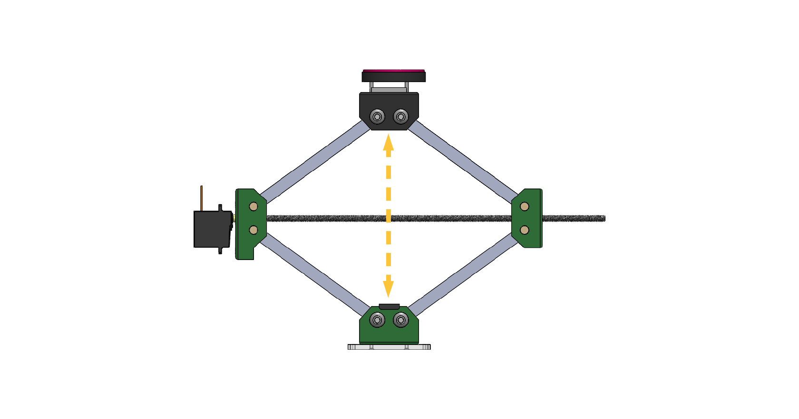
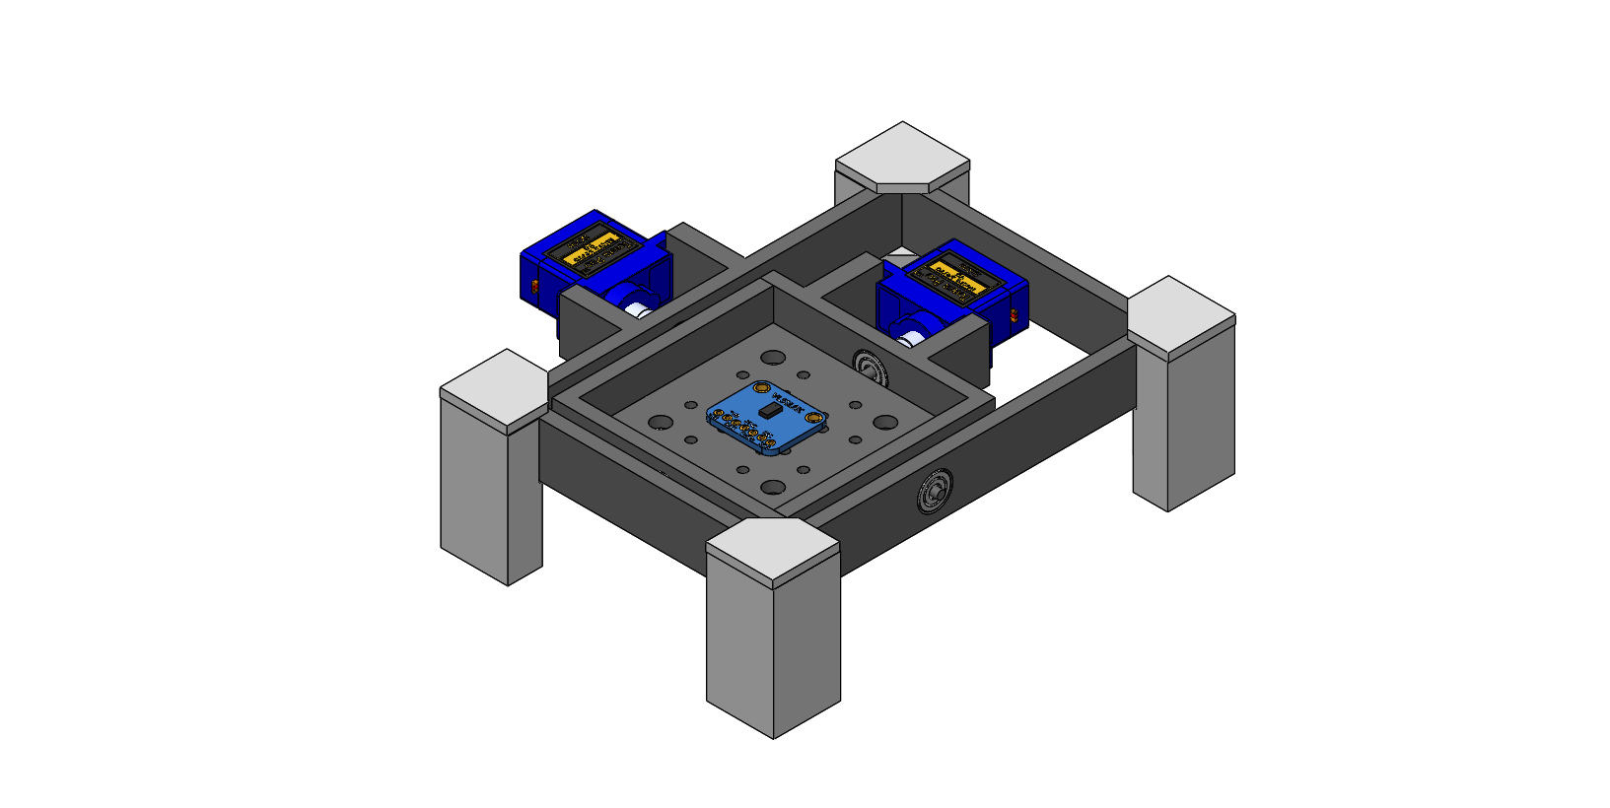
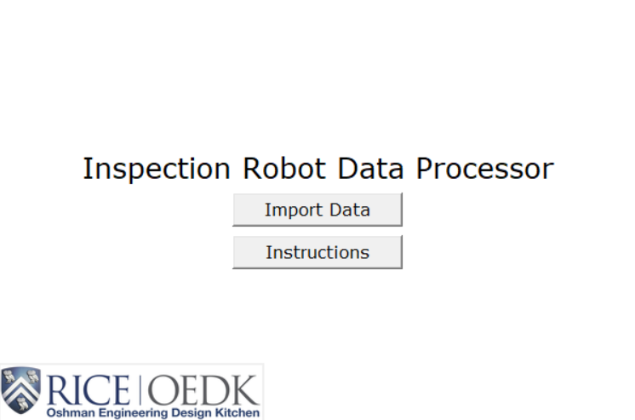
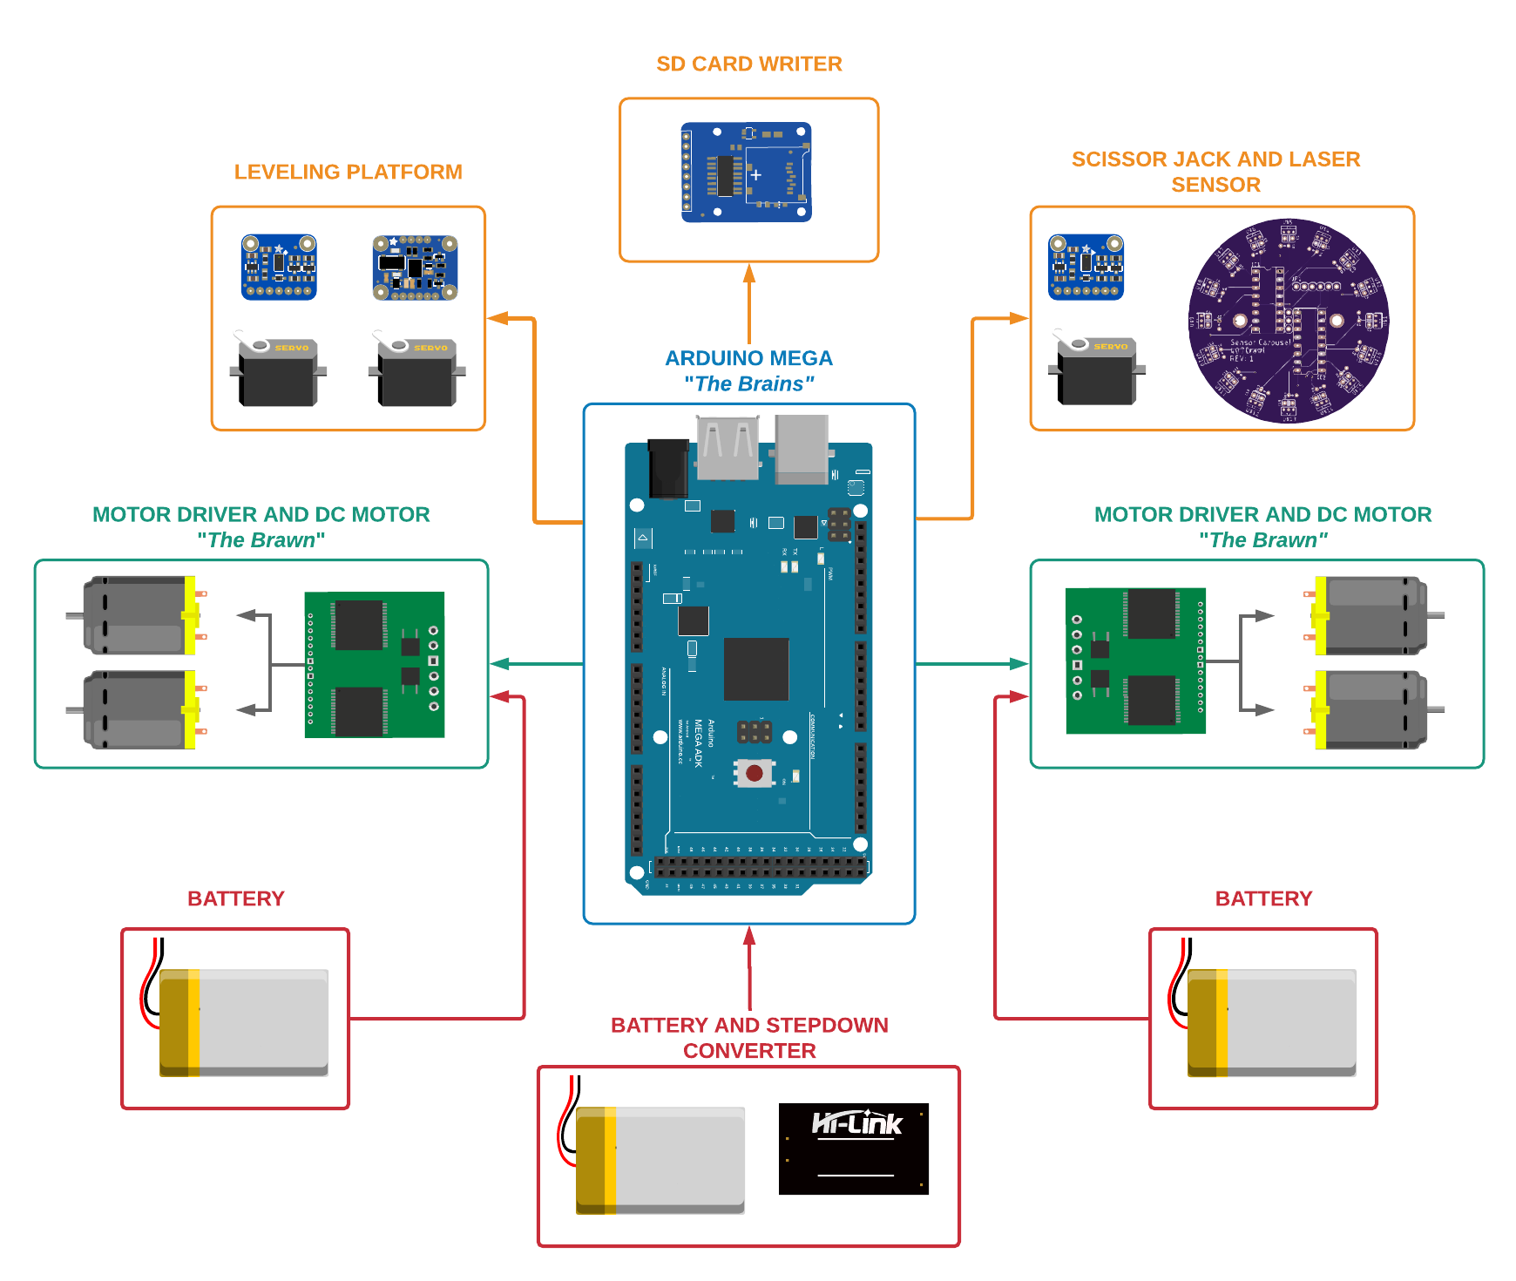


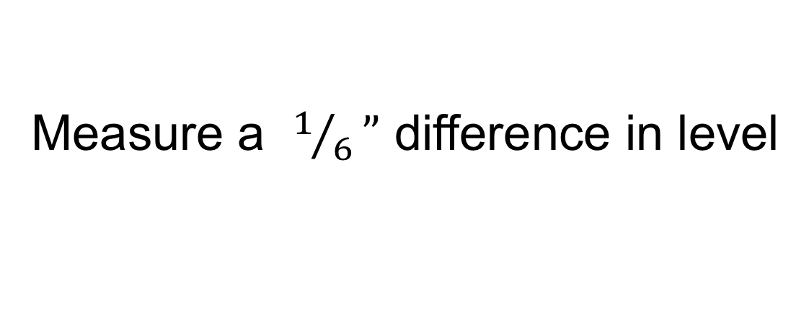

Remote-Controlled Inspection Robot for Crawl Spaces Logan Baldridge, Alvaro Castillo, Christina Mezmur, Nathalie Phillips, Tiffani Tjandra Department of Mechanical Engineering, Rice University Team 407 Crawl, 407crawl@gmail.com
Background
Inspection Robot Components
Accuracy Testing & Results
Sensor Carousel
Photodiodes on the carousel are triggered when hit by a laser
When triggered, movement of the scissor jack stops
Its circular pattern maximizes the target zone for the laser
The goal of this project is to create a device that inspects the underside of a pier and beam style house to identify problematic conditions and assist in taking measurements for the foundation leveling process.
Sensor Carousel
Leveling Platform
The results from the accuracy test showed that the measurements from the time of flight sensor are within 2% of the theoretical measurement.
Time of Flight Sensor
Gyroscope
Photodiodes
Camera Live Stream
Design Criteria
First-person View Camera on Pan-Tilt Frame
Safety
Remote-Controlled LED Lights
Does not cause harm to the user
Additionally, the test showed that the device can detect a difference in level between piers with a resolution of up to half an inch.
Does not damage the integrity of the house
Servo-Actuated Scissor Jack
Controller
Operation
Time of Flight Sensor
Battery life lasts longer than 1.5 hours
Process For Taking Measurements
Not get stuck more than once every 5 inspections
1
4
5
Minimum IP Rating of IP 45
Measure a $1/6”$ difference in level
2
Learn to use the robot in $≤$ 20 minutes
Design
A green laser on a tripod is aimed along side of the house.
A red laser is aimed along the first row of piers, such that the green hits target on red laser. This ensures a neutral datum for all measurements.
The robot is driven to the desired pier, while staying in line with the red laser.
The scissor jack is activated and oscillates upwards and downwards.
The scissor jack continues to oscillate until the photodiodes on the sensor carousel is triggered by the red laser.
Summary
Height of the robot is $≤$ 1.5 feet
Accomplishment
Our team developed a cost-effective and non-intrusive method to assist pier and beam homeowners with the leveling of their house.
Future Work
Our team will continue to improve the accuracy of our height measuring system to guarantee a resolution of 1/6”.
Cost is less than $1800
Accomplishments: Our team developed a cost-effective and non-intrusive method to assist pier and beam homeowners with the leveling of their house.
Future Work: Our team will continue to improve the accuracy of our height measuring system to guarantee a resolution of 1/6”.
Hardware Architecture
6
8
9
Roll
7
Pitch
Acknowledgements
Once triggered, the time of flight (ToF) sensor at the base of the scissor jack will record its vertical height.
The leveling platform will rotate on two axes to ensure sensors aim vertically, even if ground is not flat.
Once it is level, the ToF sensor on the platform will record the house pier height
Data is recorded onto an SD card and post-processed on a custom program, which saves it as an Excel spreadsheet and provides the user with data relevant to releveling their house.
This project was sponsored by John Treichler and Sally Wood. The design work for this project was supported by the resources of the Oshman Engineering Design Kitchen. We would also like to thank Dr. Matthew Elliott, Dr. Marcia O’Malley, Dr. Garry Woods, and Erik Welsh for their input into the project.

